Slide 1

AI-Assisted Learning Management System
Proposal and Feasibility Presentation
Hanzla Nouman CIIT/FA21-BSE-015/ATD
Laiba Binta Tahir CIIT/FA21-BSE-019/ATD
Arfah Ali CIIT/FA21-BSE-080/ATD
Supervisor
Mr. Mukhtiar Zamin
Department of Computer Science
COMSATS University Islamabad, Abbottabad Campus

Slide 2
Agenda of the Presentation
Motivation
Introduction
Scope
Functionalities
Proposed Tools/Platforms
Feasibility Analysis (Technical, Financial, Resource, Operational)
Schedule (Tasks for 1st Iteration)
Conclusion

Slide 3
Motivation
2. Importance of AI in reducing teachers' routine tasks and enhancing student learning.
1. Address challenges in traditional LMS (lack of adaptability and personalization).

Slide 4
Brief Introduction
AI-Assisted LMS Overview:
Automates content creation, grading, recommendations, and analytics.
Provides a personalized, adaptive learning experience for students.

Slide 5
Scope
What we are Doing?
Included Features
What we are not Doing?
Content Generation
Content Recommendations
AI-Driven Evaluation
Data Analytics
Excluded Features
Diaries
Real-Time Communication
Parent Engagement
Operational Tasks

Slide 6
Functionalities
Content Generation and Recommendation
(CGRe)
AI Assisted Evaluation
Data Analytics
Operational Tasks

Slide 7
Module 1: Content Generation
Create Lecture
AI-Generated Content
Save and Publish
Add Multimedia Elements
Personal Note-Taking
Edit and Update Content

Slide 8
Module 2: Content Recommendation
Personalized Resource Suggestions
Weakness Area Identification
Dynamic Learning Pathway
Teacher Insight Dashboard

Slide 9
Module 3: Self Evaluation
Customizable Quizzes
Instant Feedback
Progress Tracking
Performance Summary
Review Incorrect Answers

Slide 10
Module 4: Standard Evaluation
Create and Schedule Assessments
AI-Assisted Grading
Manual Grading Adjustments
Feedback Provision
Rubric Customization
Low-Score Review
Result Publishing

Slide 11
Module 5: Analytics
Engagement Metrics
Knowledge Gap Analysis
Class Performance Overview
Individual Performance Reports
Behavioral Analytics
Improvement Tracking
Exportable Reports
Content Effectiveness Scoring

Slide 12
Module 6: Operational Tasks (Attendance)
Mark Attendance
Attendance Reports
Daily and Monthly Attendance Summary

Slide 13
Proposed Tools/Platform
Tools and Technologies
Area/Function | Tool/Technology
Frontend Development | React
Backend Development | Node.js with Express
Database Management | MongoDB Atlas
AI and Machine Learning | Llama.cpp / Ollama
Version Control | Git and GitHub
Integrated Development Environment (IDE) | Visual Studio Code
UI/UX Design | Figma
Communication and Collaboration | Notion, Google Meet
Hosting and Deployment | Heroku or Render (Free Tier)
Programming Languages | JavaScript (ES6+), Python
Markup and Styling | HTML5, CSS3

Slide 14
Feasibility
1. Technical feasibility
Frontend
Use React for the web-based LMS interface
Backend
Utilize Node.js with Express for APIs and authentication
Database
MongoDB Atlas (Free Tier) for user data and course content
Optionally, Electron for a desktop version (if time allows)
Store local embeddings in MongoDB for minimal RAG support

Slide 15
Feasibility
1. Technical feasibility
AI Models
Content Generation: Implement Llama.cpp or Ollama with quantized models (1B or 3B parameters)
Challenges & Solutions
Model Size & Deployment: Use quantized models compatible with mid-tier hardware
Limit AI tasks to reduce resource needs
Data Syncing: Implement manual syncing via a "Sync Data" button
Evaluation Models: Use lightweight or rule-based approaches for assessments

Slide 16
Feasibility
2. Financial Feasibility
Free Resources Utilized
Frontend: | React (Open Source)
Backend: | Node.js (Open Source)
AI Integration: | Llama.cpp/Ollama (Open Source)
Database: | MongoDB Atlas Free Tier
Testing: | Manual testing by the team
Hosting: | Free-tier options like Heroku or Render
Support: | Managed internally by the team

Slide 17
3. Resource feasibility
Human Resources (Team of 3)
AI/ML Engineer
Integrate quantized Llama models
Front-End Developer
Back-End Developer
Set up APIs and data storage
Develop basic RAG functionality
Build LMS interface with React
Design dashboards and input forms
Manage user sessions and authentication

Slide 18
3. Resource feasibility
Technical Resources
Development Tools
Use GitHub Student Pack for version control
Testing Environment
Licenses
Rely on open-source software to avoid costs
Personal laptops for development and testing

Slide 19
4. Operational Feasibility
Maintenance
No further model fine-tuning needed after setup
Data Privacy & Security
Operational Challenges & Solutions
Data Syncing: Use a manual sync process instead of real-time syncing
Focus on demonstrating core AI capabilities
Support & Training
Team-managed support
Keep the system intuitive and user-friendly
Implement basic data protection measures
Secure handling of student data
Theoretical compliance with privacy standards

Slide 20
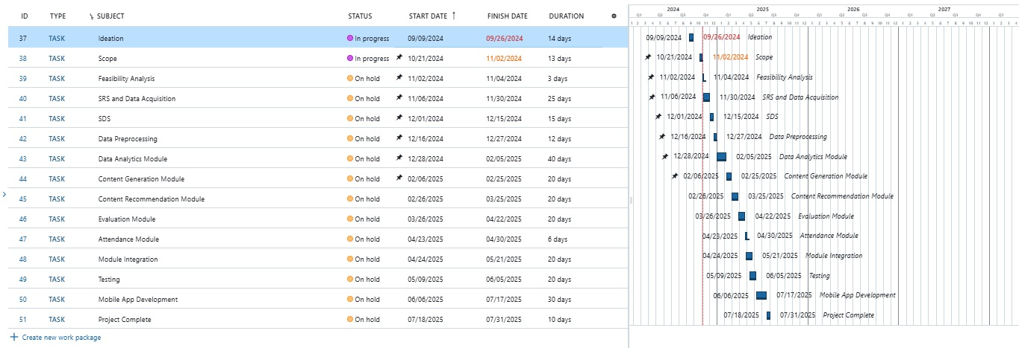
Schedule

Slide 21
Tasks for 1st Iteration (or 30%)
SRS
SDS
Basic Content Generation and LMS activities

Slide 22
Conclusion
AI-Assisted LMS aims to improve educational outcomes by reducing teacher workload, offering personalized learning, and utilizing data-driven insights.

